Slide 1

Implementing a Test Program
A test program verifies that methods behave as expected.
Steps in writing a tester class
Provide a tester class.
Supply a main method.
Inside the main method, construct one or more objects.
Apply methods to the objects.
Display the results of the method calls.
Display the values that you expect to get.

Slide 2
Implementing a Test Program
Code to test the behavior of the translate method
Rectangle box = new Rectangle(5, 10, 20, 30); // Move the rectangle
box.translate(15, 25); // Print information about the moved rectangle
System.out.print("x: ");
System.out.println(box.getX());
System.out.println("Expected: 20");
Place the code inside the main method of the MoveTester class.
Determining the expected result in advance is an important part of testing.

Slide 3
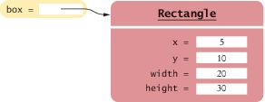
Object References
An object variable is a variable whose type is a class
Does not actually hold an object.
Holds the memory location of an object
Figure 15 An Object Variable Containing an Object Reference

Slide 4
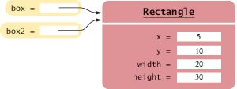
Object References
Multiple object variables can refer to the same object:
Rectangle box = new Rectangle(5, 10, 20, 30);
Rectangle box2 = box;
Figure 16 Two Object Variables Referring to the Same Object

Slide 5
Numbers
Numbers are not objects.
Number variables actually store numbers.
Figure 17 A Number Variable Stores a Number

Slide 6
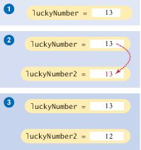
Copying Numbers
When you copy a number
the original and the copy of the number are independent values.
int luckyNumber = 13;
int luckyNumber2 = luckyNumber;
luckyNumber2 = 12;
Figure 18 Copying Numbers

Slide 7
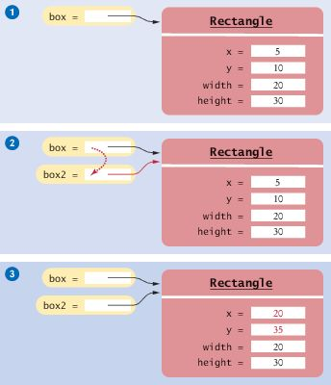
Copying Object References
When you copy an object reference
both the original and the copy are references to the same object
Rectangle box = new Rectangle(5, 10, 20, 30);
Rectangle box2 = box;
box2.translate(15, 25);
Figure 19 Copying Object References

Slide 8
Self Check 2.37
What is the effect of the assignment
greeting2 = greeting?
Answer: Now greeting and greeting2 both refer to the same String object.

Slide 9
Self Check 2.38
After calling greeting2.toUpperCase(), what are the contents of greeting and greeting2?
Answer: Both variables still refer to the same string, and the string has not been modified. Recall that the toUpperCase method constructs a new string that contains uppercase characters, leaving the original String unchanged. So both of the Strings remain unchanged

